Slide 1
Experiment No:9 Make a Dovetail joint of two wooden pieces in the shape of dovetail

Slide 2
Introduction
Carpentry may be designed as the process of making wooden articles and components such as roots, floors, partitions, doors and windows.
Carpentry involves cutting, shaping and fastening wood and other materials together to produce a finished product.
Preparation of joints is one of the important operations in wood work.
Joinery denotes connecting the wooden parts using different points such as lap joints, mortise and teman joints, bridle joints, etc.

Slide 3
Carpentry Tools
Carpentry tools are used to produce components to an exact size. The types of carpentry tools are as follows.
1. Marking tools
2.Measuring tools
3. Holding tools
4. Cutting tools
5.Planning tools
6.Boring tools
7. Striking tools
8.Miscellaneous tools

Slide 4
Marking tools
It is used to marking lines parallel to the edges of a wooden piece.
It consists of a square wooden stem with a sliding wooden stock on it.
On the stem, a marking pin is attached which is made up of steel.
This stem is provided with a steel nail to scratch the surface of the work.
It consists of two pins; the distance between the pins is adjustable. It is used to draw parallel lines on the stock.

Slide 5
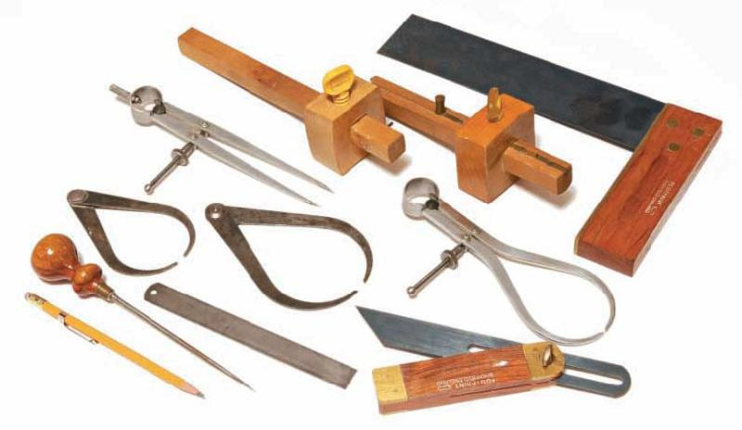
Marking tools

Slide 6
Measuring tools
The carpentry measuring tools are classified as follows
1. Steel tape 2.Steel rule 3.Calipers
Steel tapes and steel rules are mainly used for measuring short and lengths in millimeters.
A try square is used for testing squareness and marking of joints.
A mitre square is used for marking and measuring an angle of 45 degree.
A bevel square is used for marking and listing angles between 0 degree to 180 degree.
Calipers
Calipers are used for the precision measurement of cylindrical surface. Inside calipers are used for measuring outside diameter and outside calipers are used to measure inner diameter of a pipe

Slide 7
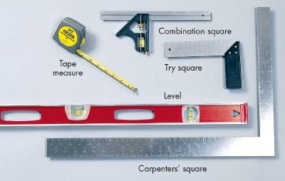
Measuring tools

Slide 8
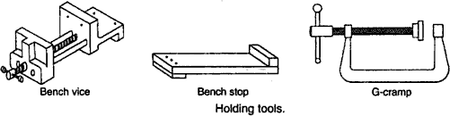
Holding tools
The carpentry holding tools are shown in fig.

Slide 9
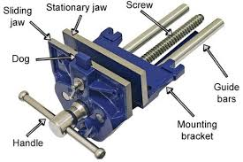
Carpentry vice
A carpentry vice is the common work holding device. It consists of one fixed jaw and one movable jaw. Its one jaw is fixed to the side of the table while the other is movable by means of a screw and a handle.

Slide 10
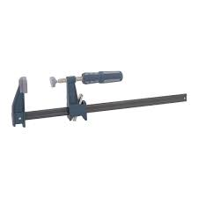
Bar clamp
The bar clamp (or) sash cramps are generally used in pairs in glueing up operations at the final assembly of joinery work. It is made up of a steel bar of T-section, wine malleable iron fittings and a steel screw.

Slide 11
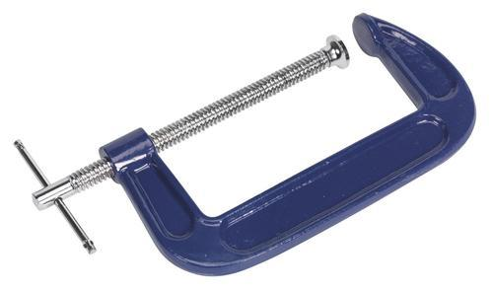
G-cramp
G-cramp is made up of malleable iron with acme threads of high quality steel .It can be used for clamping small work when glueing up.

Slide 12
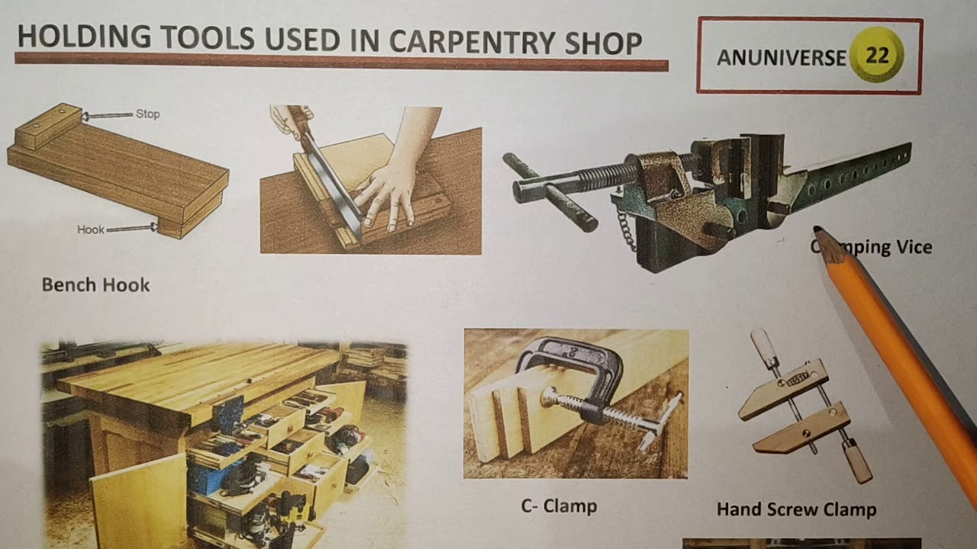

Slide 13
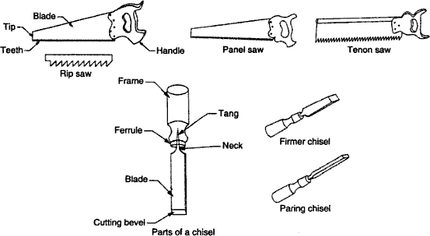
Cutting Tools

Slide 14
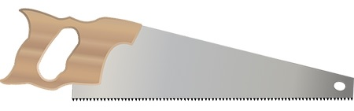
Saws
A saw is used to cut wood into pieces. There is different type of saws, designed to suit different purpose. A saw is specified by the length of its tooled edge. The following saws are used in the carpentry section.

Slide 15
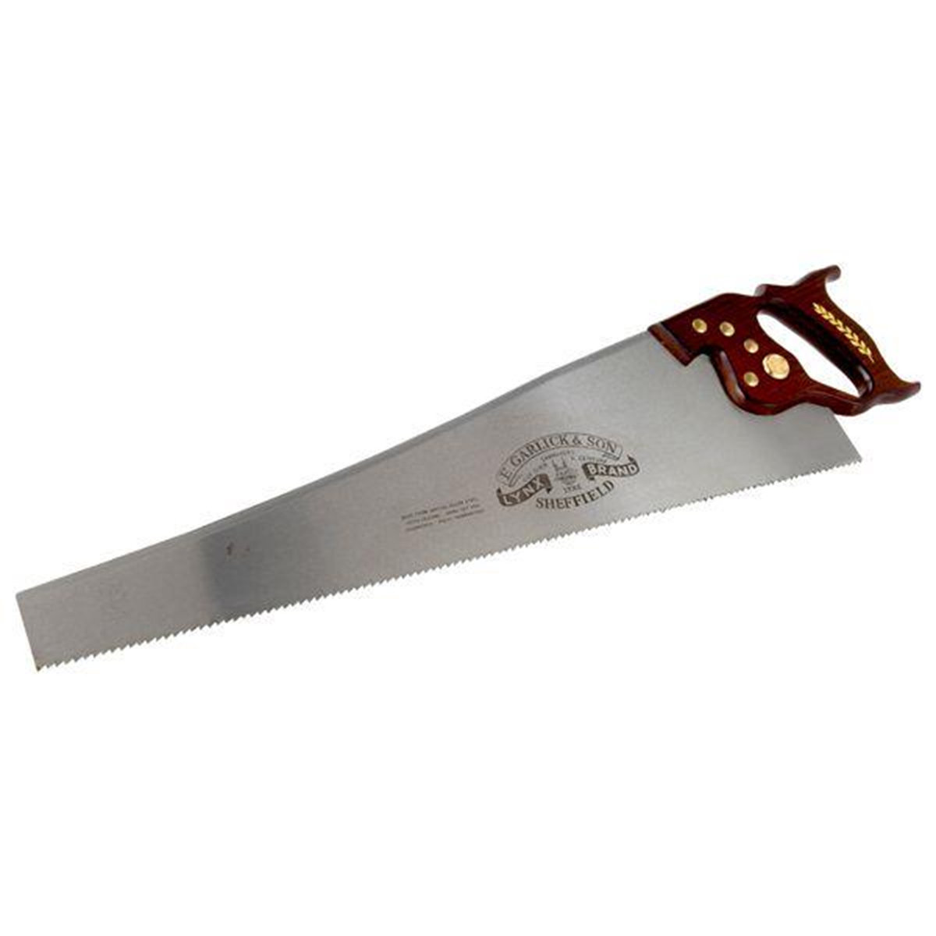
Rip Saw
The blade of rip saw is either straight or skew-backed. The teeth are so set that the cutting edge of this saw makes a steeper angle about 60⁰

Slide 16
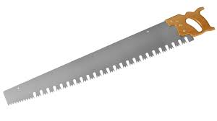
Cross Cut saw
This is similar in shape of a rip saw. It is used to cut across the grain of the stock. The correct angle for cross cutting is 45⁰.The teeth are so set that the saw kerf is wider than the blade thickness. This allows the blade to move freely in the cut without sticking.

Slide 17
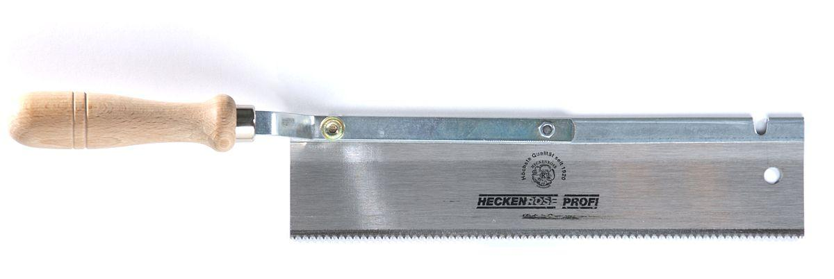
Tenon or back saw
A tenon saw is used for fine and accurate work. It consists of a very fine blade, which is reinforced with a rigid steel back. The teeth are shaped like those of cross cut saw.

Slide 18
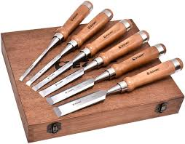
Chisels
Chisels are used for cutting and shaping wood accurately. Wood chisels are made in various blade widths, ranging from 3 to 50mm .Most of the wood chisels are made into tang type, having a steel shank which fits inside the handle.

Slide 19
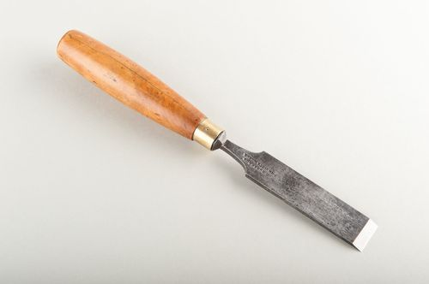
Firmer chisels
These are general purpose chisels and are used either by hand pressure or by a mallet. The blade of a firmer chisel is flat and their sloping face is at an angle 15⁰ to 52⁰

Slide 20
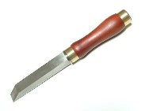
Mortise Chisels
These are general purpose chisels and are used for cutting mortises above 9 mm wide. The blade of a firmer type in which they have a thicker section and a stronger neck. By means of this chisel we can apply more Leverage to remove waste wood from the mortise

Slide 21
Bevel chisels
A bevel chisel is similar in construction to the firmer chisel. Its edges are bevelled to allow access to difficult corners. It has a blade with a bevelled back due to which it can enter sharp corners for finishing in dovetail joints.

Slide 22
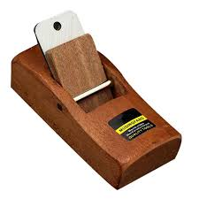
Planing Tools
In general, planes are used to produce flat surfaces on wood. The cutting blade used in a place is very similar to a chisel. The blade of a plane is fitted in a wood or metallic block at an angle

Slide 23
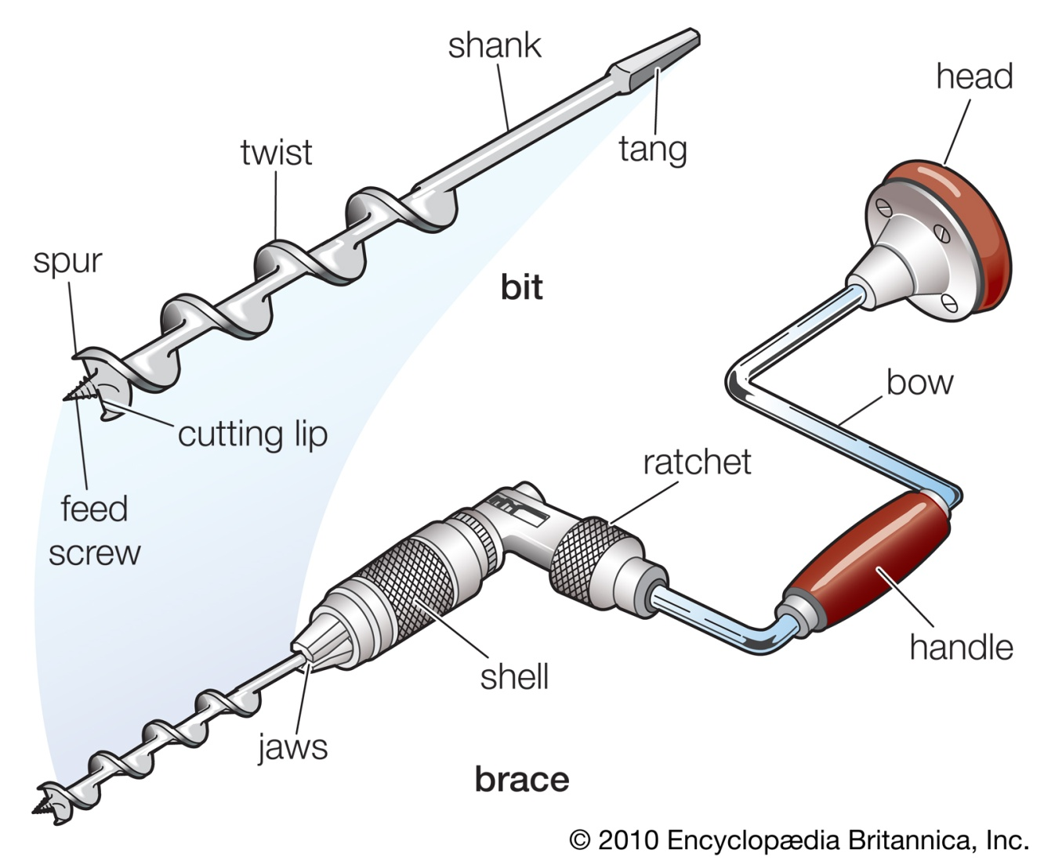
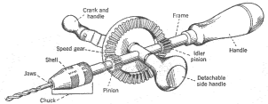
Boring tools There are two types of drill used to bore holes: Ratchet brace Wheel brace

Slide 24
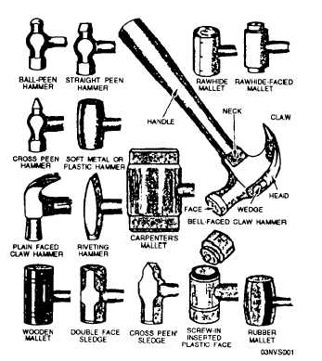
Striking tools

Slide 25
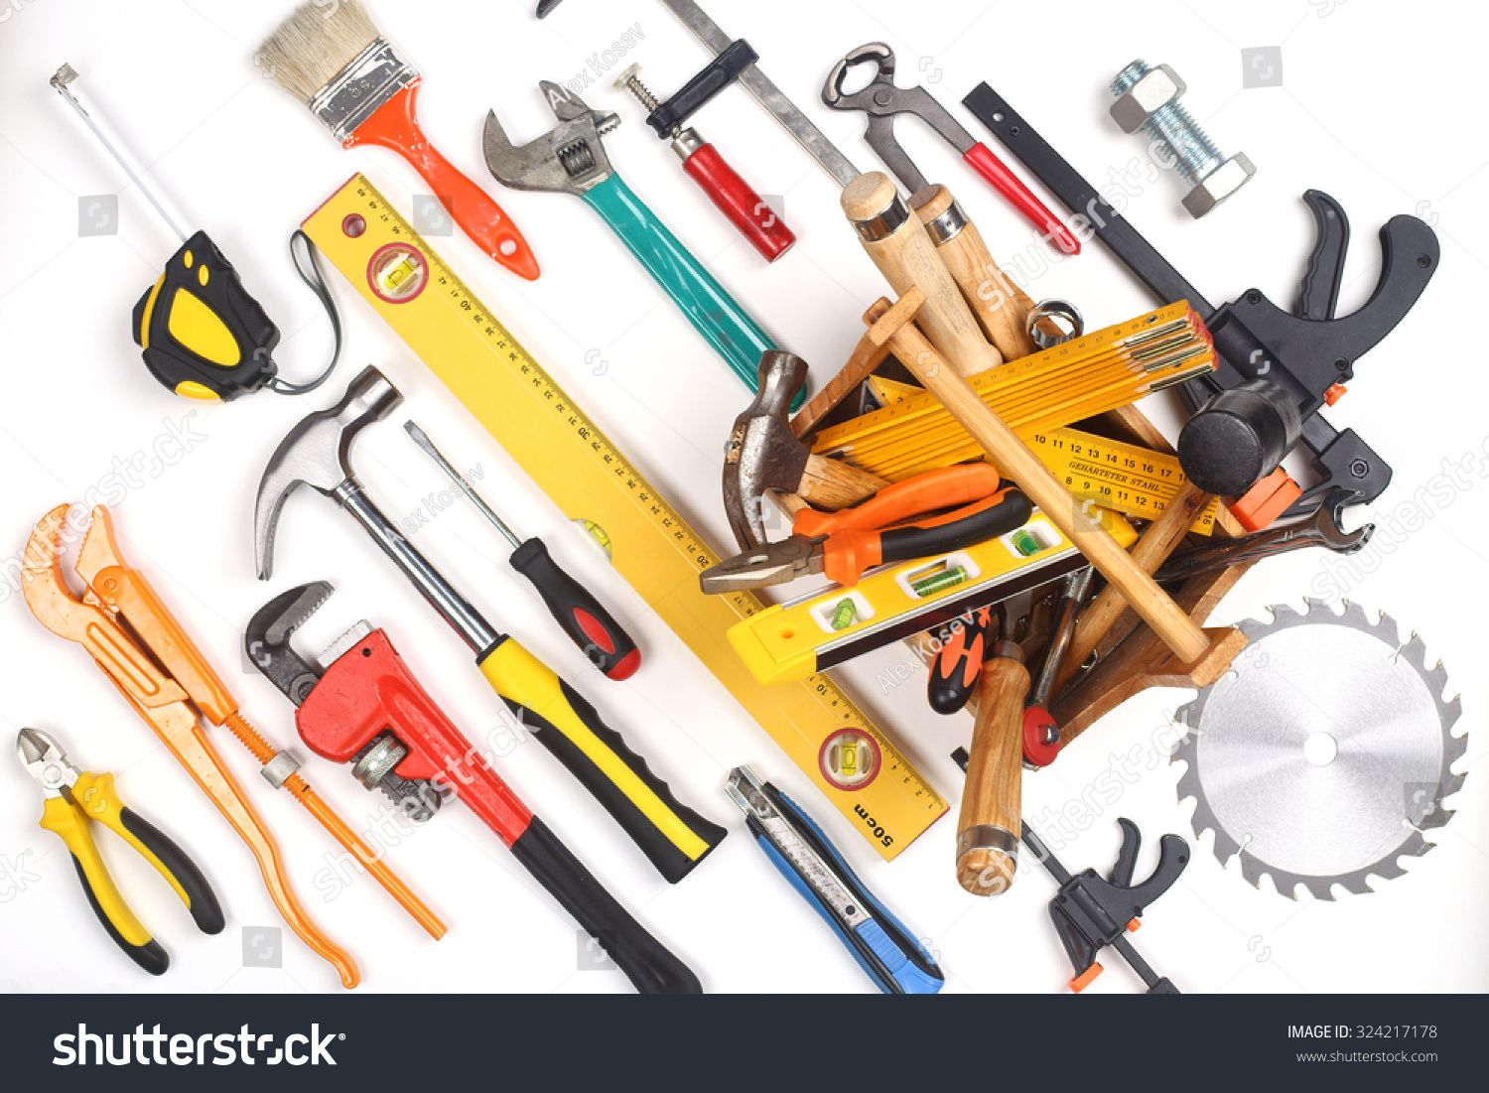
Miscellaneous tools

Slide 26
DOVE TAIL JOINT
AIM:
To produce a Dove tail joint from the given work piece.
APPLICATION:
Cross bars in a cot, shelves.
SUPPLIED MATERIAL SPECIFICATION:
Venteek wood of size 150 x 45 x 30

Slide 27
TOOLS REQUIRED:
1) Jack plane. 2) Hand saw. 3) Steel rule.
4) Pencil 5) Marking Gauge. 6) Try square
7) Firmer Chisel. 8) Cleaning brush. 9) Wooden mallet.
SEQUENCE OF OPERATION:
1) Preparing.2) Marking. 3) Cutting/Sawing. 4) Finishing.
WORKING STEPS:
1) PREPARING:
a) Prepare the work piece as described in previous with a length of 150mm, 45mm and 30mm.

Slide 28
2) MARKING:
a) Adjust the marking gauge to 15mm and set out the distance from the face side (A) at one end of the face edges (B).
b) With try square & scriber check a perpendicular line in the face side (A), from the marked line at a distance of 45mm from the end. This will produce a rectangular of 45 x 15 at the end of the face of the edge (B)
c) Now on (A) side ark a line on all four side & on (B) side mark fast after 53mm second one after 45mm
d) Mark a line on 6 inches from the steel rule measurement.
e) Now on (A) side mark 45mm after 5m or up and down side.
f) Then on(B) side after 53mm & 45mm in between mark 5mm on top & bottom.

Slide 29
3) CUTTING / SAWING:
a) First, hand sawing the back part of the (A) side tills the marking.
b) Then saw the 5mm & 5mm marking on the (B) side and use firmer chisel and wooden mallet to chip off the wood.
c) Now use Rasp to remove extra 5mm on up & down on (A) side
d)Use Rasp to smooth up the sawed area and the join up two pieces once you cut the piece by and saw from the middle.
e) Join the two pices in form of 'T'

Slide 30
4) FINISHING:
Take a series of small cuts delicately on both the side pieces to remove the excess wood.
Obtain a fine finish of the socket and shoulder assembly joint and clear off the waste by wire brush
RESULT:
The Dove tail joint was produced from the given work piece and assembled joint was submitted for evaluation.

Slide 31
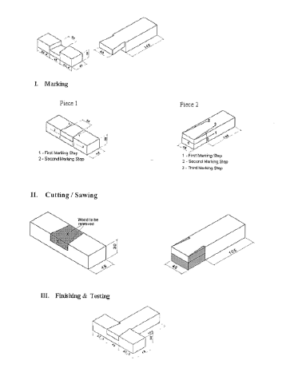

Slide 32
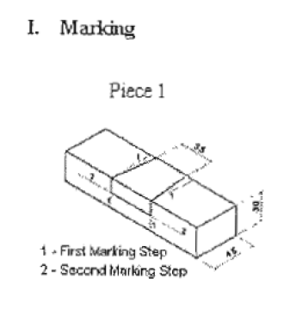
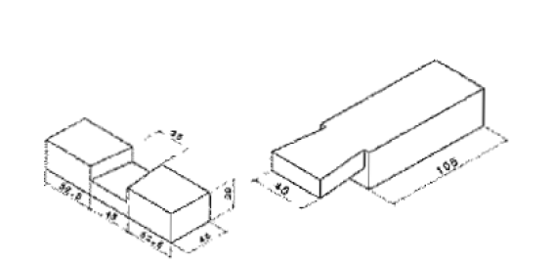
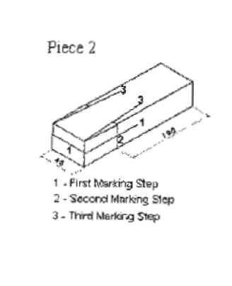

Slide 33
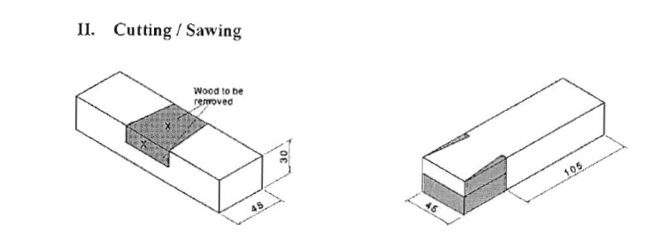

Slide 34
